Slide 1
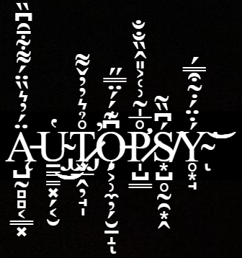


Slide 2

卂Ꮆ乇几ᗪ卂
Introduction
Features
Screenshots
Demo
Results
Conclusion
References

Slide 3

Introduction
Digital Forensics
Autopsy
Digital forensics is the scientific examination and analysis of data held on, or retrieved from, computer storage media in such a way that the information can be used as evidence in a court of law.

Slide 4

Introduction
Digital Forensics
Autopsy
Digital forensics activities commonly include:
the secure collection of computer data
the identification of suspect data
the examination of suspect data to determine details such as origin and content
the presentation of computer-based information to courts of law
the application of a country's laws to computer practice.

Slide 5


Introduction
Digital Forensics
Autopsy
Autopsy is an easy to use, GUI-based program that allows you to efficiently analyze hard drives and smart phones. It has a plug-in architecture that allows you to find add-on modules or develop custom modules in Java or Python.
It can analyze Windows and UNIX disks and file systems (NTFS, FAT, UFS1/2, Ext2/3, etc.).

Slide 6

Features
Multi-User Cases: Collaborate with fellow examiners on large cases.
Timeline Analysis: Displays system events in a graphical interface to help identify activity.
Keyword Search: Text extraction and index searched modules enable you to find files that mention specific terms and find regular expression patterns.
Web Artifacts: Extracts web activity from common browsers to help identify user activity.
Registry Analysis: Uses RegRipper to identify recently accessed documents and USB devices.
LNK File Analysis: Identifies short cuts and accessed documents
Email Analysis: Parses MBOX format messages, such as Thunderbird.
EXIF: Extracts geo location and camera information from JPEG files.

Slide 7
Features
Media Playback and Thumbnail viewer.
Robust File System Analysis: Support for common file systems, including NTFS, FAT12/FAT16/FAT32/ExFAT, HFS+, ISO9660 (CD-ROM), Ext2/Ext3/Ext4, Yaffs2,
Unicode Strings Extraction: Extracts strings from unallocated space and unknown file types in many languages
File Type Detection based on signatures and extension mismatch detection.
Interesting Files Module will flag files and folders based on name and path.
Android Support: Extracts data from SMS, call logs, contacts, Tango, Words with Friends, and more.

Slide 8

ֆƈʀɛɛռֆɦօȶֆ

Slide 9
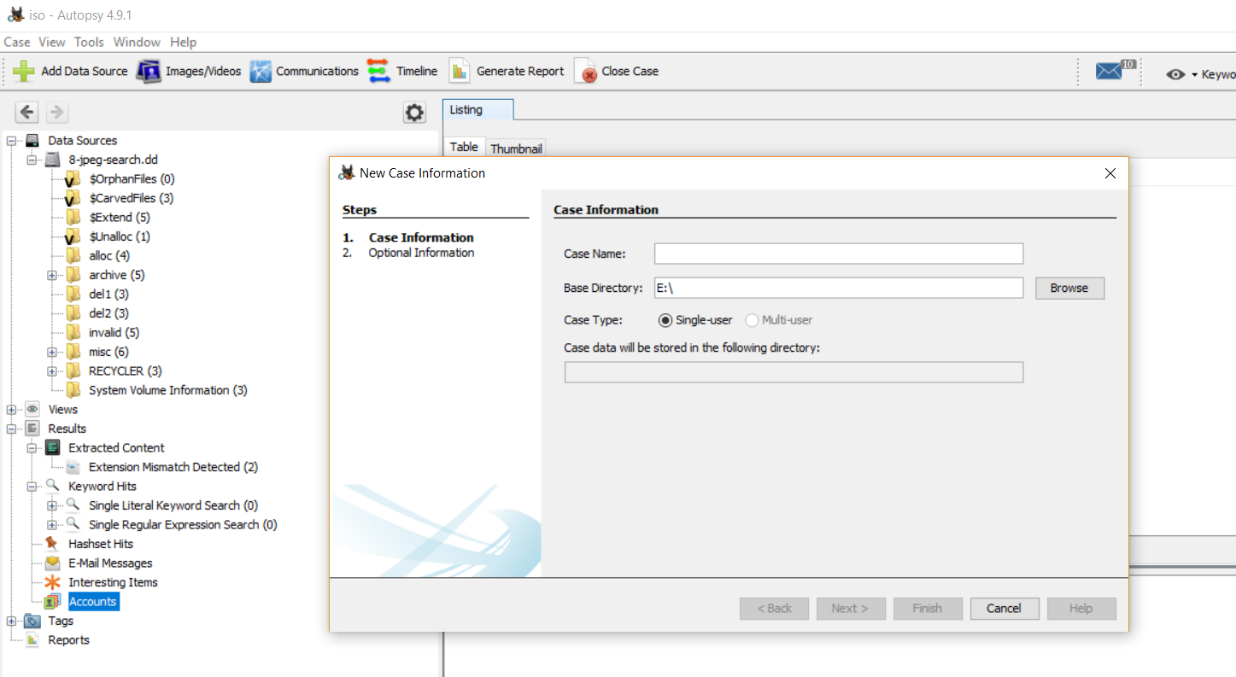
1

Slide 10
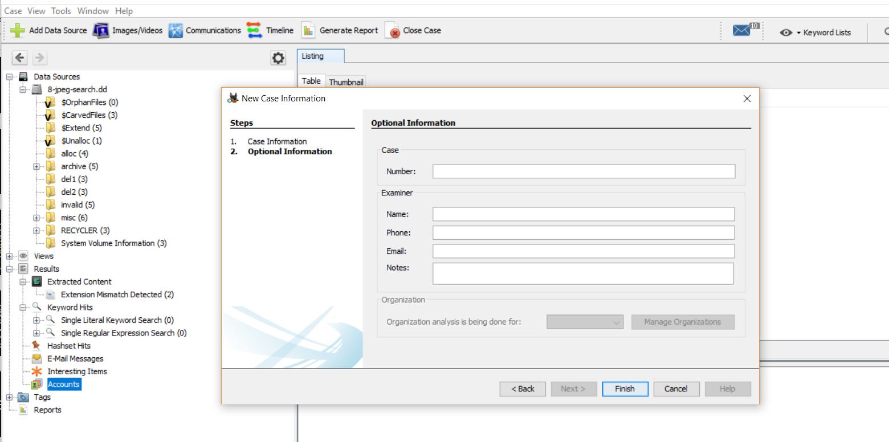
2

Slide 11
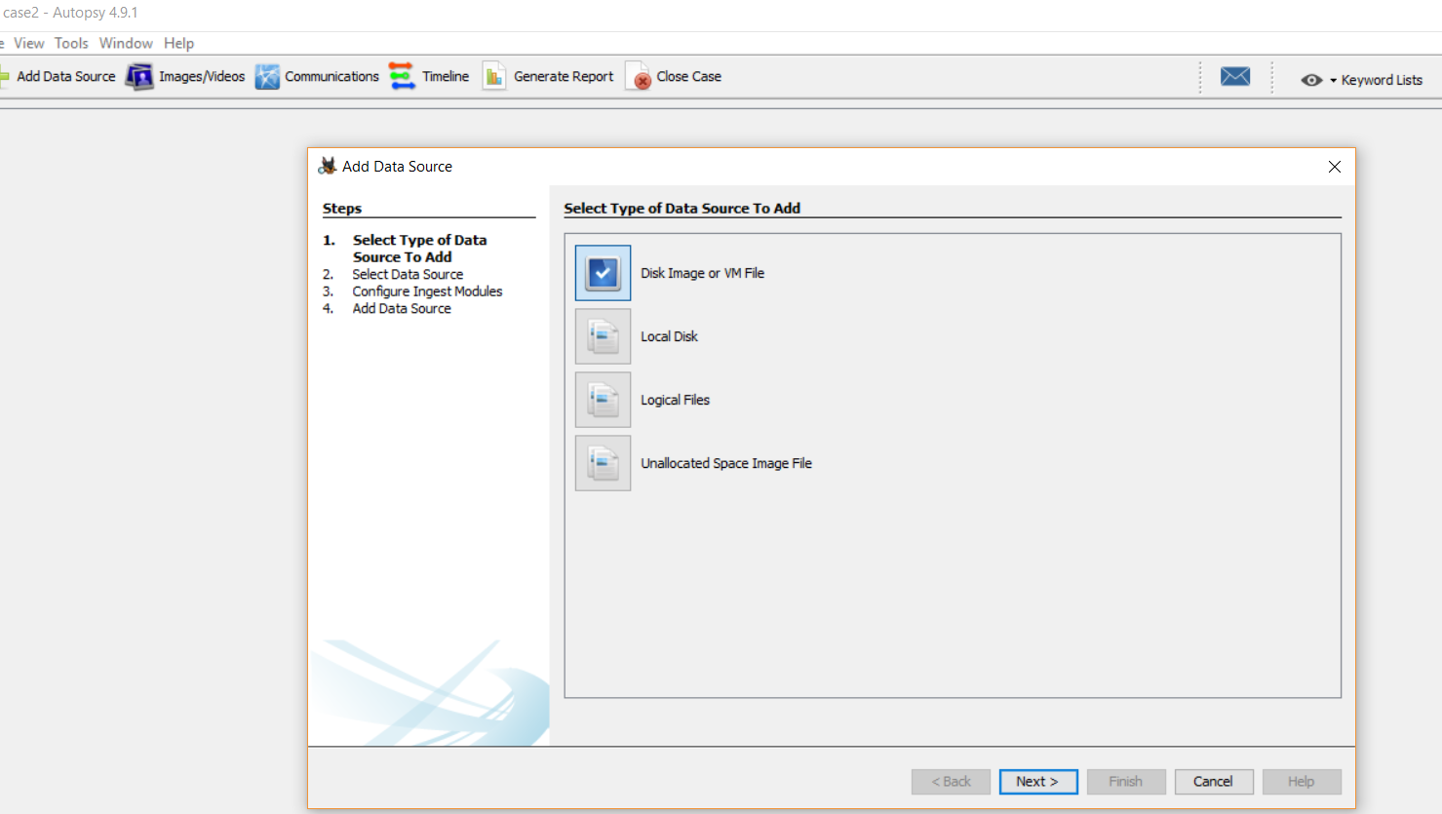
3

Slide 12
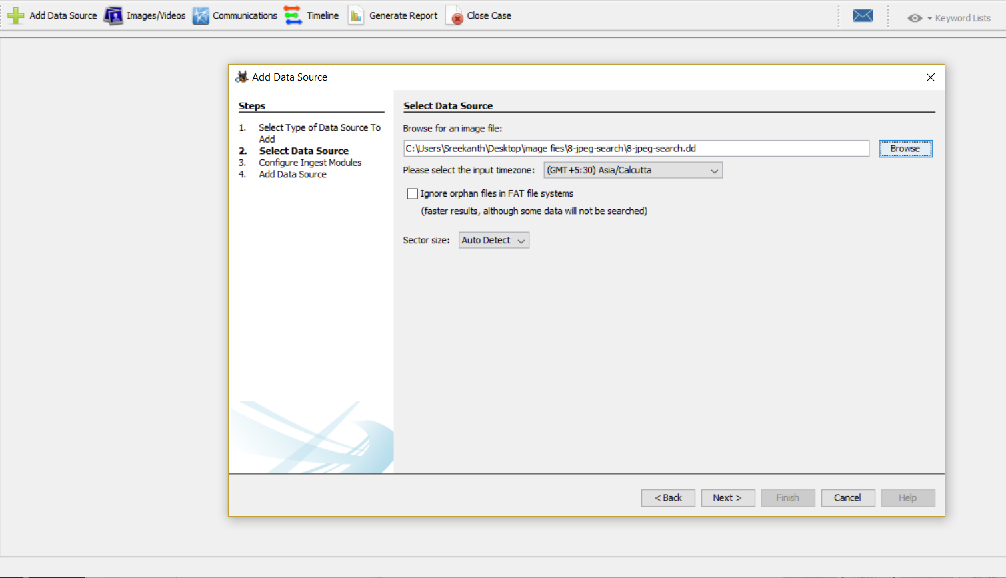
4

Slide 13
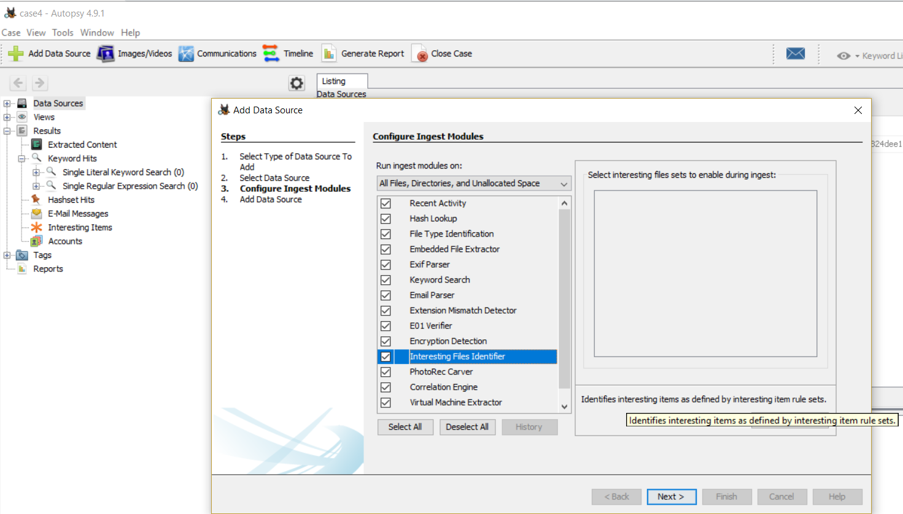
5

Slide 14

яєѕυℓтѕ

Slide 15
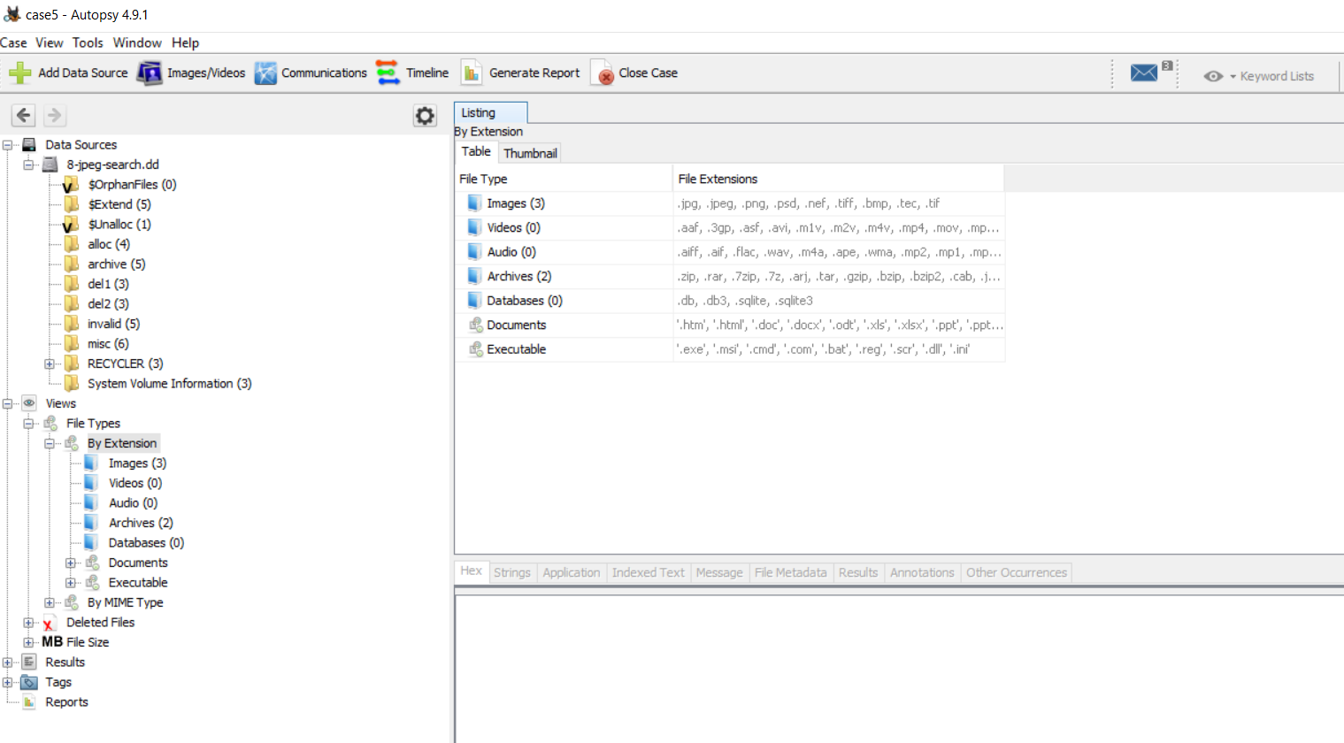

Slide 16



Slide 17


